Slide 1

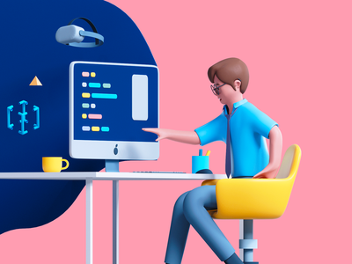
Human Computer Interface Unit-II Design Process
Lecture By: Syed Nawaz Pasha
Assistant Professor
CS&AI
Class: CSE-II/I

Slide 2
What is Design
Design is defined as achieving goals with constraints
Goals: What is the purpose of the design we are intending to produce? Who is it for? Why do they want it?
Constraints: What materials must we use? What standards must we adopt? How much can it cost? How much time do we have to develop it?
Trade-off : Choosing which goals or constraints can be relaxed so that others can be met.
A design can be prototype, product, or process

Slide 3
Interactive Design
Interaction Design is the process of creating interactive products and services
Interaction design is a process in which designers focus on creating engaging web interfaces with logical and thought out behaviors and actions.
Successful interactive design uses technology and principles of good communication to create desired user experiences.
Interaction design Basics
Design:
What it is, Goals and constraints
Design process:
What happens when
Users:
Who they are, What they are

Slide 4
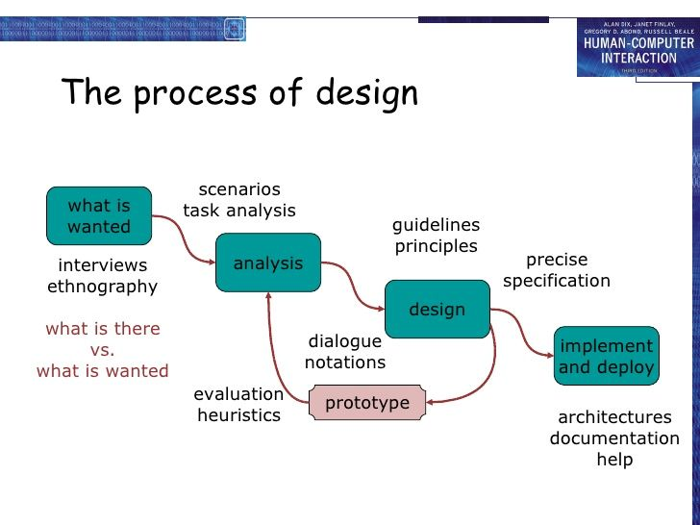
The Design Process

Slide 5
The Design Process
1. Requirements
What is wanted? The first stage is establishing what exactly is needed.
Interviewing people, videotaping them, looking at the documents and objects that they work with, observing them directly.
2. Analysis
The results of observation and interview need to be ordered in some way to bring out key issues and communicate with later stages of design.

Slide 6
The Design Process
3. Design
Well, this is all about design, but there is a central stage when you move from what you want, to how to do it. There are numerous rules, guidelines and design principles that can be used to help with this.
4. Iteration and prototyping
Humans are complex and we cannot expect to get designs right first time. We therefore need to evaluate a design to see how well it is working and where there can be improvements.

Slide 7
The Design Process
5. Implementation and deployment
Finally, when we are happy with our design, we need to create it and deploy it. This will involve writing code, perhaps making hardware, writing documentation and manuals – everything that goes into a real.

Slide 8
Design Rules
Shneiderman’s 8 golden rules of interface design
Norman’s 7 principles.

Slide 9
Shneiderman’s 8 golden rules of interface design
Strive for consistency
Enable frequent users to use shortcuts
Offer informative feedback
Design dialogue to yield closure
Offer simple error handling
Permit easy reversal of actions
Support internal locus of control
Reduce short term memory load.

Slide 10
Strive for Consistency
Elements such as fonts, color, shape, and position being consistently the same in all menus & screens, across, categories for a particular software.
Users should be able to do the same thing in the same way that they have been doing every time.
The sequence of actions that we perform must be in a similar situation.

Slide 11
Enable frequent users to use shortcuts
The needs of diverse users must be recognized for facilitating the transformation of content.
Users are classified as NOVICE, INTERMEDIATE, and EXPERTS. Experts tend to use lesser actions at a faster pace.
Interfaces need to cater to all levels of users.

Slide 12
Offer Informative Feedback
For every action there should be appropriate, human-readable feedback within a reasonable amount of time.
A bad example we often see is when an error message shows an error-code instead of a human-readable and meaningful message.

Slide 13
Design Dialogue to Yield Closure
Don’t keep your users guessing.
Tell them what their action has led them to.
For example, users would appreciate a “Thank You” message and a proof of purchase receipt when they’ve completed an online purchase.

Slide 14
Offer simple error handling
users are provided with simple, intuitive step-by-step instructions to solve the problem as quickly and painlessly as possible.

Slide 15
Permit easy reversal of actions
Designers should aim to offer users obvious ways to reverse their actions.
This feature relieves anxiety, since the user knows that errors can be undone; it thus encourages exploration of unfamiliar options.

Slide 16
Support internal locus of control
Allow your users to be the initiators of actions.
Give users the sense that they are in full control of events occurring in the digital space.
Earn their trust as you design the system to behave as they expect.

Slide 17
Reduce short-term memory load
Interfaces should be as simple as possible with proper information hierarchy, and choosing recognition over recall.
For example, we often find the format of multiple choice questions easier than short answer questions on a test because it only requires us to recognize the answer rather than recall it from our memory.

Slide 18
Norman’s 7 principles.
To assess the interaction between human and computers, Donald Norman in 1988 proposed seven principles. He proposed the seven stages that can be used to transform difficult tasks.
Following are the seven principles of Norman −
Use both knowledge in world & knowledge in the head.
Simplify task structures.
Make things visible.
Get the mapping right (User mental model = Conceptual model = Designed model).
Exploit the power of constraints (Physical constraints, Cultural constraints, Technological constraints).
Design for Error.
When all else fails − Standardize.

Slide 19
Use both knowledge in world & knowledge in the head.
Knowledge in the world is readily available to the user. Knowledge in the head is internalized knowledge.
Effective design that assists users capitalizes on both external cues in the world and internal user knowledge.

Slide 20
Simplify the structure of Tasks
Short term memory limits people to about five unrelated items at a time.
Long term memory is limited by accessibility.
To reduce the load on a user's memory, if tasks are similar, keep them similar.
Use features like tooltip,undo and history to help aid memory.

Slide 21
Make things visible: bridge the gulfs of Execution and Evaluation
The user should know how the task is executed and should be able to evaluate the outcome.
Always give good feedback to the user about the system state and make the outcome of their actions as obvious as possible.

Slide 22
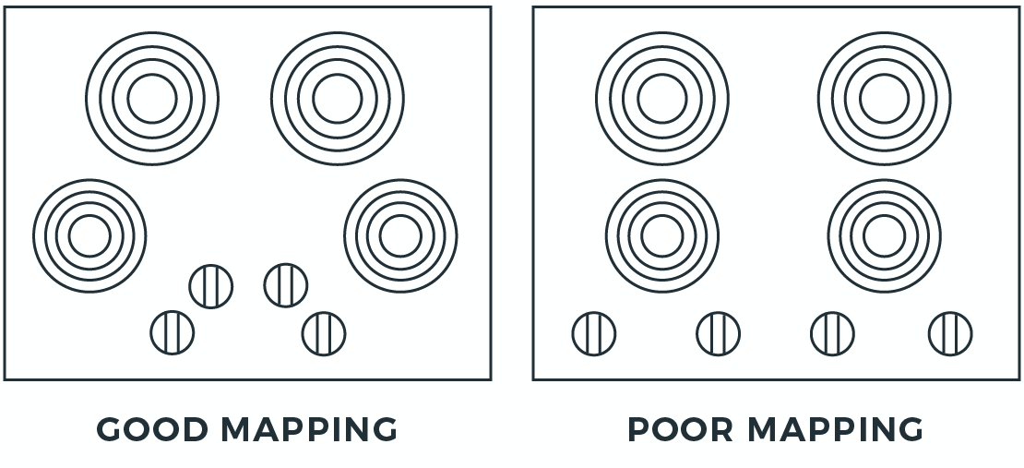
Get the mapping Right
Users expect execution and evaluation to naturally map to something they know.

Slide 23
Exploit the power of constraints
Constraints prevents errors from occurring by taking the control out of the users hand.
Example application requires email registration.

Slide 24
Design for error
"Anything that can go wrong, will" is useful to keep in mind when considering how users engage with a system.
Prepare to support user's actions, not fight against them.
Help users recover from errors.
Example: Gmail undo

Slide 25
When all else fails, standardize
When natural mappings are difficult or impossible, standardize actions, outcomes, layouts, and displays for predictability and consistency.

Slide 26
Prototyping
Prototyping is an experimental process where design teams implement ideas into tangible forms from paper to digital.
A Prototype is a tangible artifact,not detailed description of product.
There are three main approaches to prototyping:
Throw-away
Incremental
Evolutionary

Slide 27
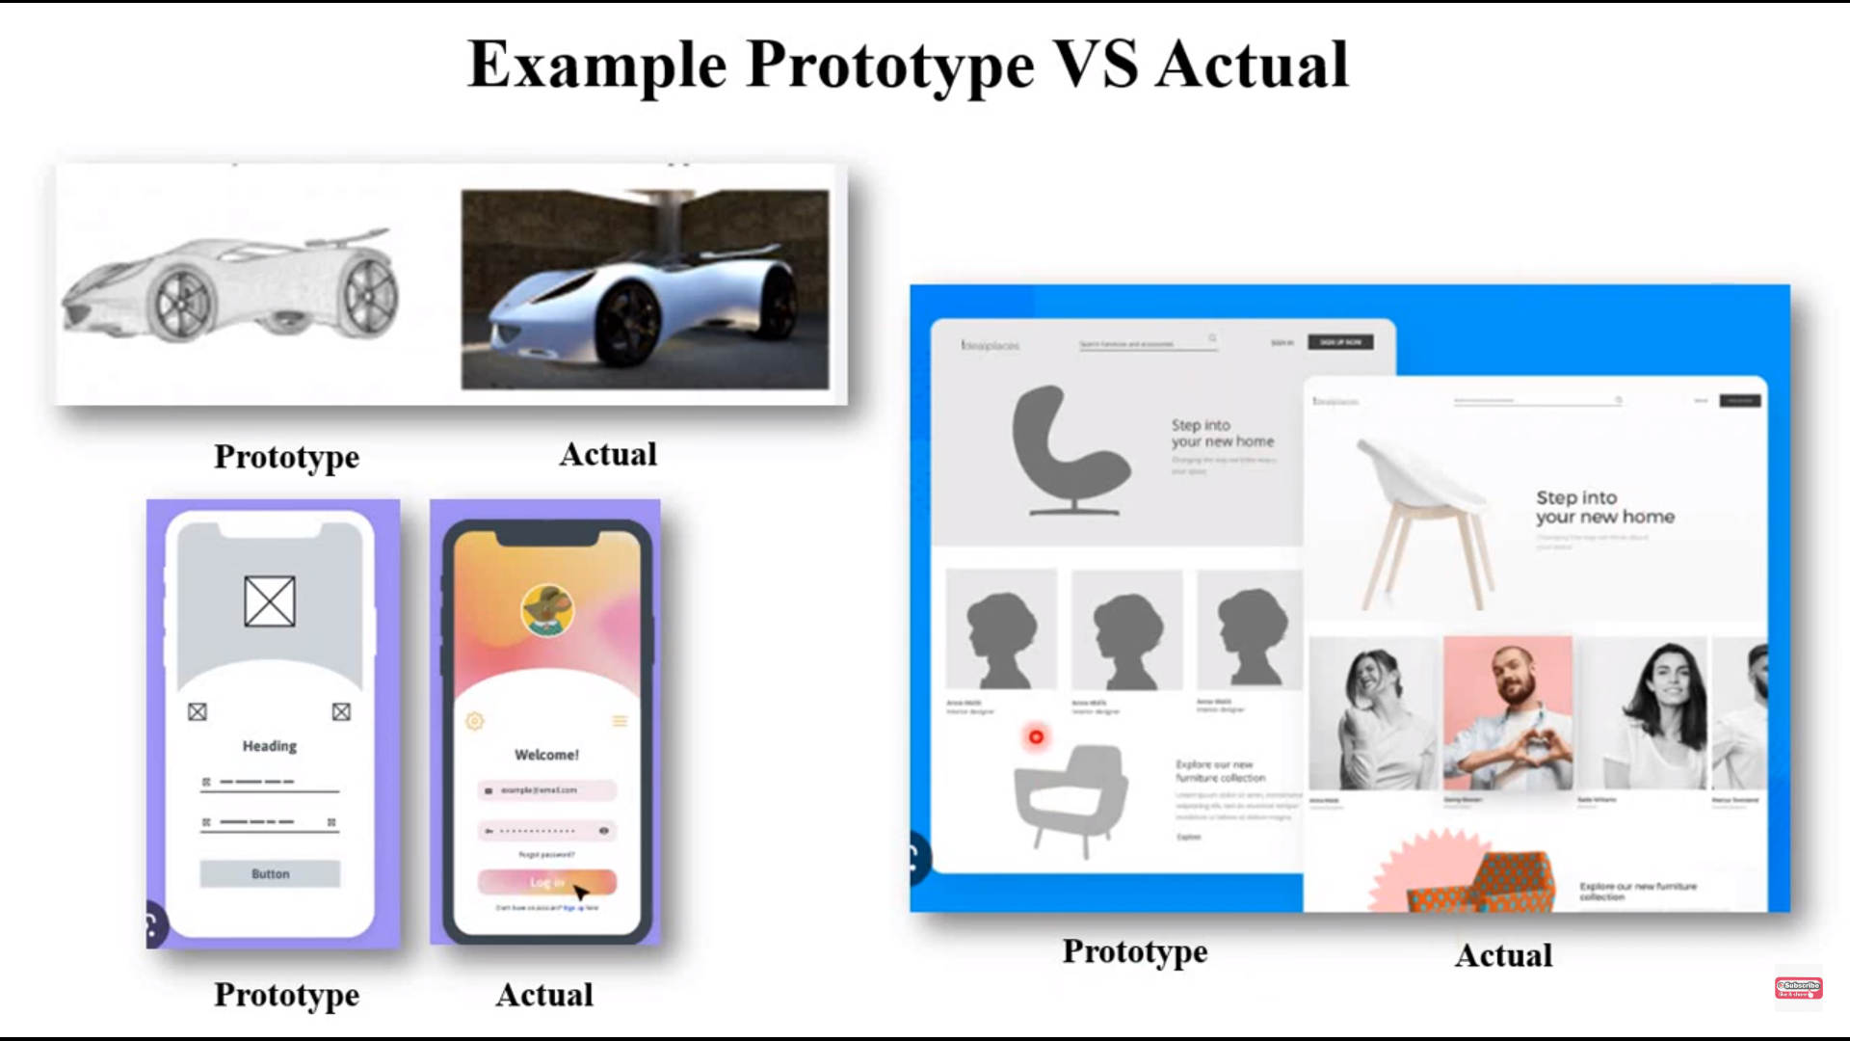
Prototype Vs Actual Design

Slide 28
Prototyping
In interaction design prototyping can be done through:
a series of screen sketches
a storyboard, i.e. a cartoon-like series of scenes
a Powerpoint slide show
a video simulating the use of a system
a lump of wood
a cardboard mock-up
a piece of software with limited functionality written in the target language or in another language

Slide 29
High-Fidelity and Low-Fidelity Prototyping
Low-fidelity prototypes are often paper-based and do not allow user interactions.
They range from a series of hand-drawn mock-ups to printouts. In theory, low-fidelity sketches are quicker to create.
High-fidelity prototypes are computer-based, and usually allow realistic (mouse-keyboard) user interactions.
High-fidelity prototypes take you as close as possible to a true representation of the user interface.

Slide 30
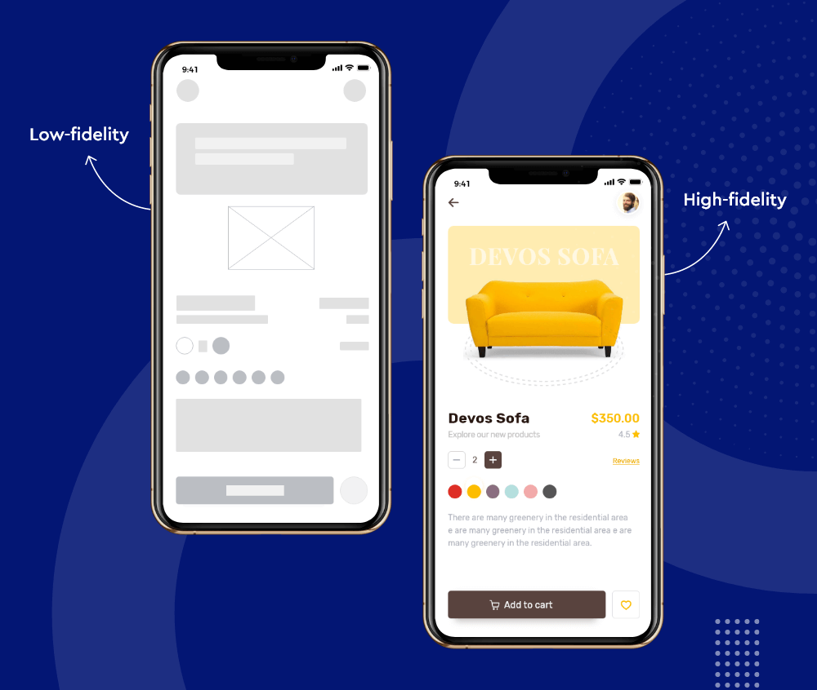
Lo-Fi Vs Hi-Fi

Slide 31
Throw-Away Prototyping
It is based on the initial specifications for the software programs.
The team can quickly create the disposable prototype to demonstrate how the system’s basic requirements would seem visually.
In this technique, consumer input aids in influencing modifications to the specifications, and after receiving user feedback, a new prototype is made to satisfy the client’s expectations.
Previous prototypes become useless as software development progresses through its various stages.

Slide 32
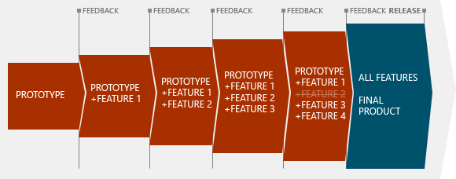
Throw-Away Prototyping

Slide 33
Evolutionary Prototyping
After accepting the customer’s final comments, the team develops evolutionary prototypes in an iteratively revised manner.
The team can cut back significantly on development time and work by using this kind of prototype.
In general, evolutionary prototyping in software development is helpful when the software requirement is not fully known or it is unstable in the beginning.
The prototype can be viewed and used by the user just like the final product.

Slide 34
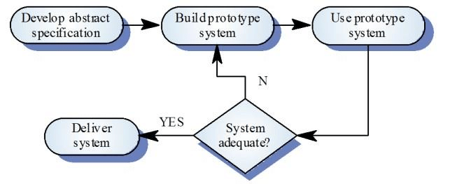
Evolutionary Prototyping

Slide 35
Incremental Prototyping
This kind of prototyping involves creating several, scaled-down versions of each component of the full software solution.
When all of these prototypes are complete, they are integrated to create a single large prototype that depicts the finished software.
All developers and development must be properly synchronized, which is a distinct difference in incremental prototyping.

Slide 36
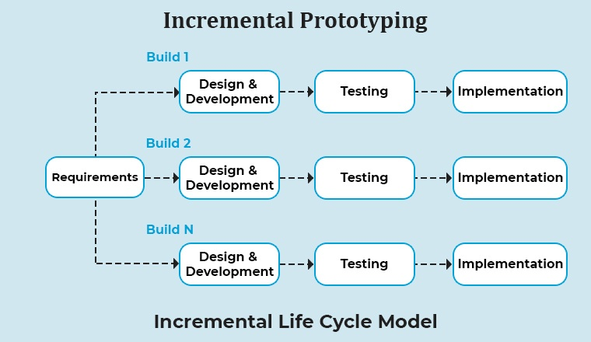
Incremental Prototyping

Slide 37
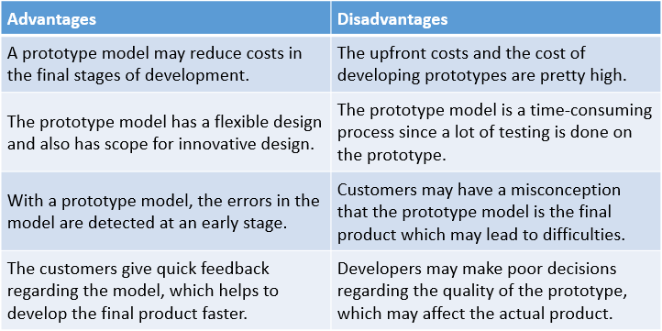
Advantages/Disadvantages of Prototyping

Slide 38
Heuristic Evaluation
A Heuristic Evaluation, or Usability Audit, is an evaluation of an interface by one or more Human Factors experts.
Evaluators measure the usability, efficiency, and effectiveness of the interface based on 10 usability heuristics originally defined by Jakob Nielsen in 1994.

Slide 39
Nielsen’s 10 Usability Heuristics
Visibility of the system status.
Match between system and real world(speak user’s language,follow real world conventions).
User control and freedom(support undo and redo).
Consistency and standards.
Error prevention.
Recognition rather than recall
Is delhi the capital of India? Recognition
What is the capital of India?.
Flexibility and easy of use(Flexible processses can be carried out in many ways).
Aesthetic and Minimalist Design(signal to noise ratio).
Help Users Recognize, Diagnose, and Recover from Errors.
Help and Documentation.

Slide 40
Models and Theories
An interaction model, sometimes called a task model, is an abstract description of how one user perceives the functions and purpose of a system from his perspective.
Task models describe what users do (activities) with systems and how they do it (tasks).

Slide 41
Models and Theories: Cognitive Model
The cognitive models we discuss include:
Hierarchical models (Goal and Task hierarchies): Represent a user`s task and goal structure
Linguistic models: Represent the user-system grammar
Physical and device models: Represent human motor skills

Slide 42
Goals vs. Tasks
Goals – intentions of the user - what you would like to be true
Tasks – actions of the user - how to achieve the goals.
Goals are internal whereas actions are external

Slide 43
GOMS
Goals: These are the user’s goals, describing what the user wants to achieve
Operators: These are the lowest level of analysis. They are the basic actions that the user must perform in order to use the system
Methods: There are several ways in which a goal can be split into subgoals. Such ways are called methods
Selection: The mechanism of selecting which method to use

Slide 44
GOMS Example
GOAL: CLOSE-WINDOW
. [select GOAL: USE-MENU-METHOD
. MOVE-MOUSE-TO-FILE-MENU
. PULL-DOWN-FILE-MENU
. CLICK-OVER-CLOSE-OPTION
GOAL: USE-CTRL-W-METHOD
. PRESS-CONTROL-W-KEYS]
For a particular user:
Rule 1: Select USE-MENU-METHOD unless another
rule applies
Rule 2: If the application is GAME,
select CTRL-W-METHOD

Slide 45
Cognitive Complexity Theory
CCT has two parallel descriptions:
User Goals
Computer system goals
The description of the user’s goals is based on GOMS like goal hierarchy but it is expressed primarily using production rules
Production rules are of the form:
if condition then action
If the condition is true then the production rules are said to fire

Slide 46
Linguistic models
The linguistic models try to Understand the user's behaviour and cognitive difficulty based on analysis of language between user and system.
The models include:
Backus–Naur Form (BNF)
Task–Action Grammar (TAG)

Slide 47
Backus-Naur Form (BNF)
BNF has been used widely to specify the syntax of computer programming languages. It is a very common notation from computer science
It is a purely syntactic view of the dialogue
The names in BNF description are of two types:
Terminals and Non-Terminals
Terminals
They are shown in upper case
They represent the lowest level of user behaviour
e.g. CLICK-MOUSE, MOVE-MOUSE
Non-terminals
They are shown in lower case
They represent higher level of abstraction
e.g. select-menu, position-mouse

Slide 48
Backus-Naur Form (BNF)
Basic syntax:
nonterminal ::= expression (where the symbol “ ::= ” can be understood as “is defined as”)
An expression
An expression may contain terminals and non-terminals
It is made up of two operators: combined in sequence (+) or as alternatives (|)

Slide 49
Example of BNF – Drawing a line
draw line ::= select line + choose points + last point
select line ::= pos mouse + CLICK MOUSE
choose points ::= choose one | choose one + choose points
choose one ::= pos mouse + CLICK MOUSE
last point ::= pos mouse + DBL CLICK MOUSE
pos mouse ::= NULL | MOVE MOUSE+ pos mouse

Slide 50
Task Action Grammar (TAG)
TAG aims at making consistency more explicit, which is lacking in BNF
TAG includes elements such as parameterized grammar rules to emphasize consistency and encoding user's world knowledge
Non-terminals are modified to include additional semantic features

Slide 51
Task Action Grammar (TAG) - consistency
To illustrate consistency in TAG, let us consider three unix commands cp (copy file), mv (move file) and ln (link file)
In BNF, these three UNIX commands would be described as:
copy ::= cp + filename + filename | cp + filenames + directory
move ::= mv + filename + filename | mv + filenames + directory
link ::= ln + filename + filename | ln + filenames + directory
No BNF measure could distinguish between this and a less consistent grammar in which
link ::= ln + filename + filename | ln + directory + filenames

Slide 52
Task Action Grammar (TAG) - consistency
In TAG, consistency of argument order is made explicit using a parameter, or semantic feature for file operations
In TAG feature, Possible values for previous example would be:
Op = copy; move; link
Rules
file-op[Op] ::= command[Op] + filename + filename
| command[Op] + filenames + directory
command[Op = copy] ::= cp
command[Op = move] ::= mv
command[Op = link] ::= ln

Slide 53
Physical and device models
The Keystroke Level Model (KLM) uses cognitive understanding as a basis for detailed predictions about user performance.
Based on empirical knowledge of human motor system, the user's task is split into two phases: acquisition phase then execution phase.
Acquisition of the task is when the user builds a mental representation of the task
Then, Execution of the task is done using the system facilities.

Slide 54
Keystroke Level Model (KLM)
KLM is related to the GOMS model. And can be thought of as a very Lowest Level of GOMS
The model decomposes the execution phase into five different physical motor operators, a mental operator and a system response operator
Physical Motor operators:
K – Keystroking, actually striking keys
B – Pressing a mouse button P – Pointing the mouse at the target H – Homing, switching hand between mouse & keyboard D – Drawing lines using mouse
Mental operator:
M – Mentally Preparing for physical action
System response operator:
R – System Response, which may be ignored if the user doesn’t wait for it

Slide 55
Keystroke Level Model (KLM) - Example
For example, consider that we are using a mouse based editor. If we notice a single character error then, we will point at the error, delete the character and retype it correctly and then return to our previous typing point. This is decomposed as follows:
1. Move hand to mouse H (mouse)
2. Position mouse after bad character PB (left click)
3. Return to keyboard H (Keyboard)
4. Delete character MK (Delete)
5. Type the correct character K (Char)
6. Reposition to paused point H (Mouse) MPB (left click)
The model predicts the total time taken during the execution phase by adding the component times for each activity as shown:
Texecute = Tk + Tp + Th + Td + Tm + Tr + Tb

Slide 56
KLM – An Example – Time comparison
GOAL: ICONISE-WINDOW
[select
GOAL: USE-CLOSE-METHOD
. MOVE-MOUSE-TO- FILE-MENU
. PULL-DOWN-FILE-MENU
. CLICK-OVER-CLOSE-OPTION
GOAL: USE-CTRL-W-METHOD
PRESS-CONTROL-W-KEY]
Compare alternatives
(by assuming hand starts on mouse)
USE-CTRL-W-METHOD vs.
USE-CLOSE-METHOD
USE-CTRL-W-METHOD
H[to kbd] 0.40
M 1.35
K[ctrlW key] 0.28
Total 2.03 s
USE-CLOSE-METHOD
P[to menu] 1.1
B[LEFT down] 0.1
M 1.35
P[to option] 1.1
B[LEFT up] 0.1
Total 3.75 s

Slide 57
MENTAL MODEL
Mental models indicate what a user expects to happen based on experience; they help us construct expected interactions with reality.
One famous example is the "Norman Door": what is the expectation for push or pull?
We expect doors to work in a certain way based on our past experiences with similar doors, and when they don't, we become confused and frustrated.

Slide 58
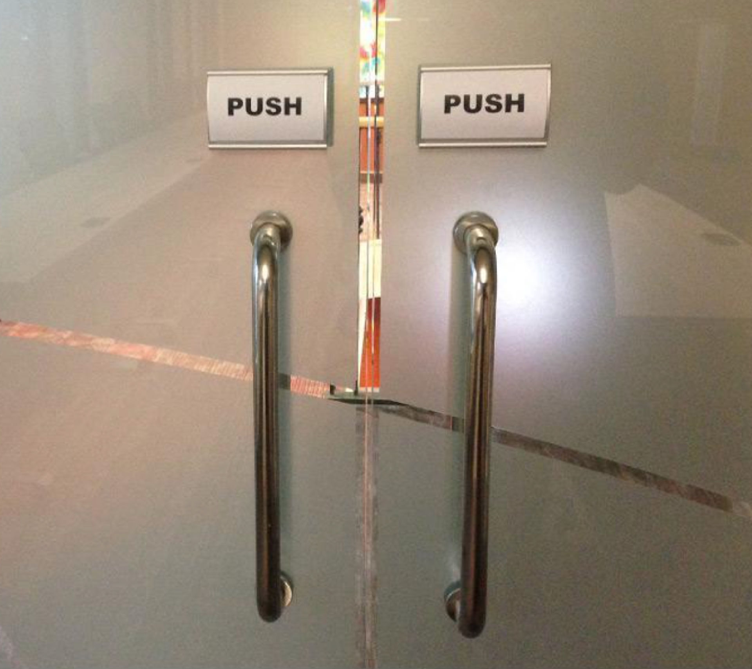
MENTAL MODEL

Slide 59
MENTAL MODEL
In most instances, the stored expectation will, to a certain extent, resemble the real-life model or prior UI experience.
This is important because users will plan and predict future actions within a system based on their mental models. It's also why consistency is so important in UI design.

Slide 60
MENTAL MODEL
Designers often make the mistake of designing based on their own mental models, which can cause a mismatch with the users' mental models.
Users may understand differently how a product or service should work, and if the design doesn't match their mental model, it can lead to confusion and frustration.
For example, frequent social media platform users develop a mental model of how social media interfaces work, and they will expect other social media sites to have similar interfaces.

